Slide 1
A comparison of Machine Learning algorithms using the Iris dataset.
Shane Gore
Udacity Challenge Course
July 2018

Slide 2
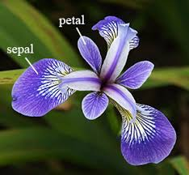
Background
The Iris data set
The Iris dataset is an open source data set downloadable from from the UCI machine learning repository.
The data set consists of fifty samples from each of three species of Iris. For each sample, four features were measured, namely: the length and the width of both the petals and sepals.
Aim: To compare the accuracy of three commonly utilised machine learning techniques to predict species.

Slide 3
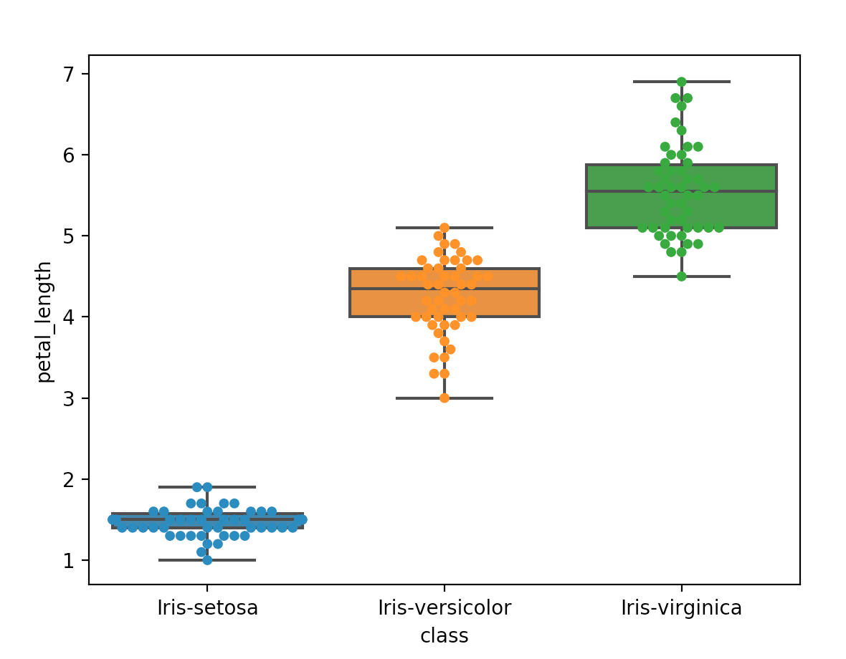
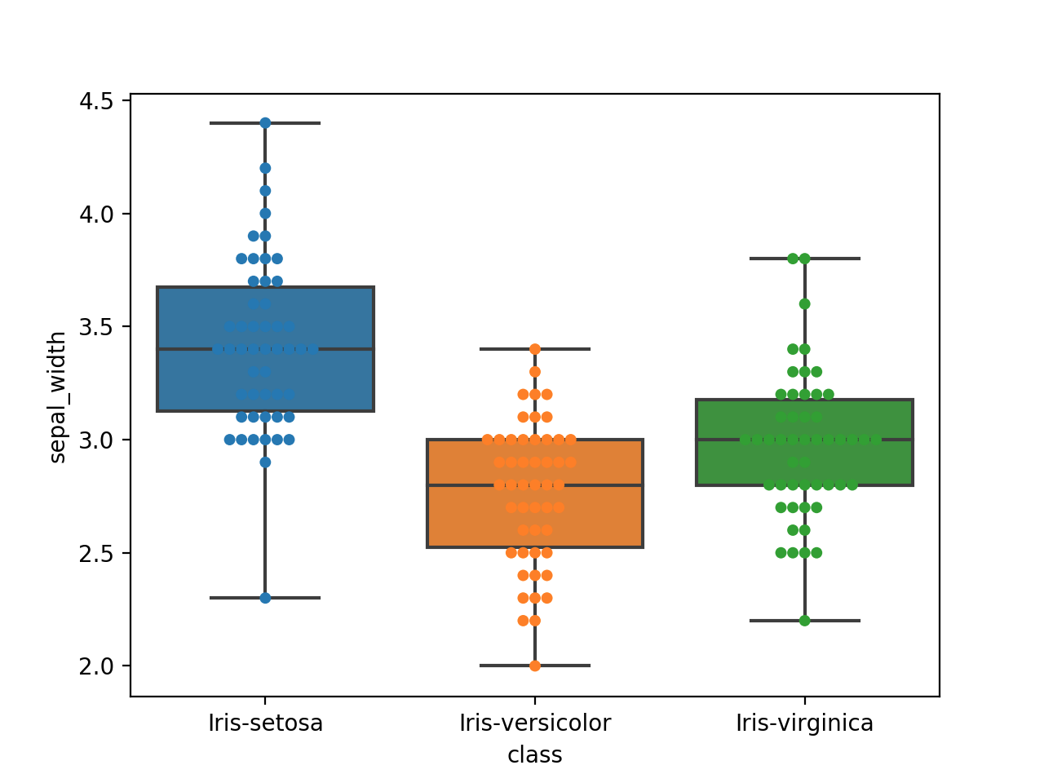
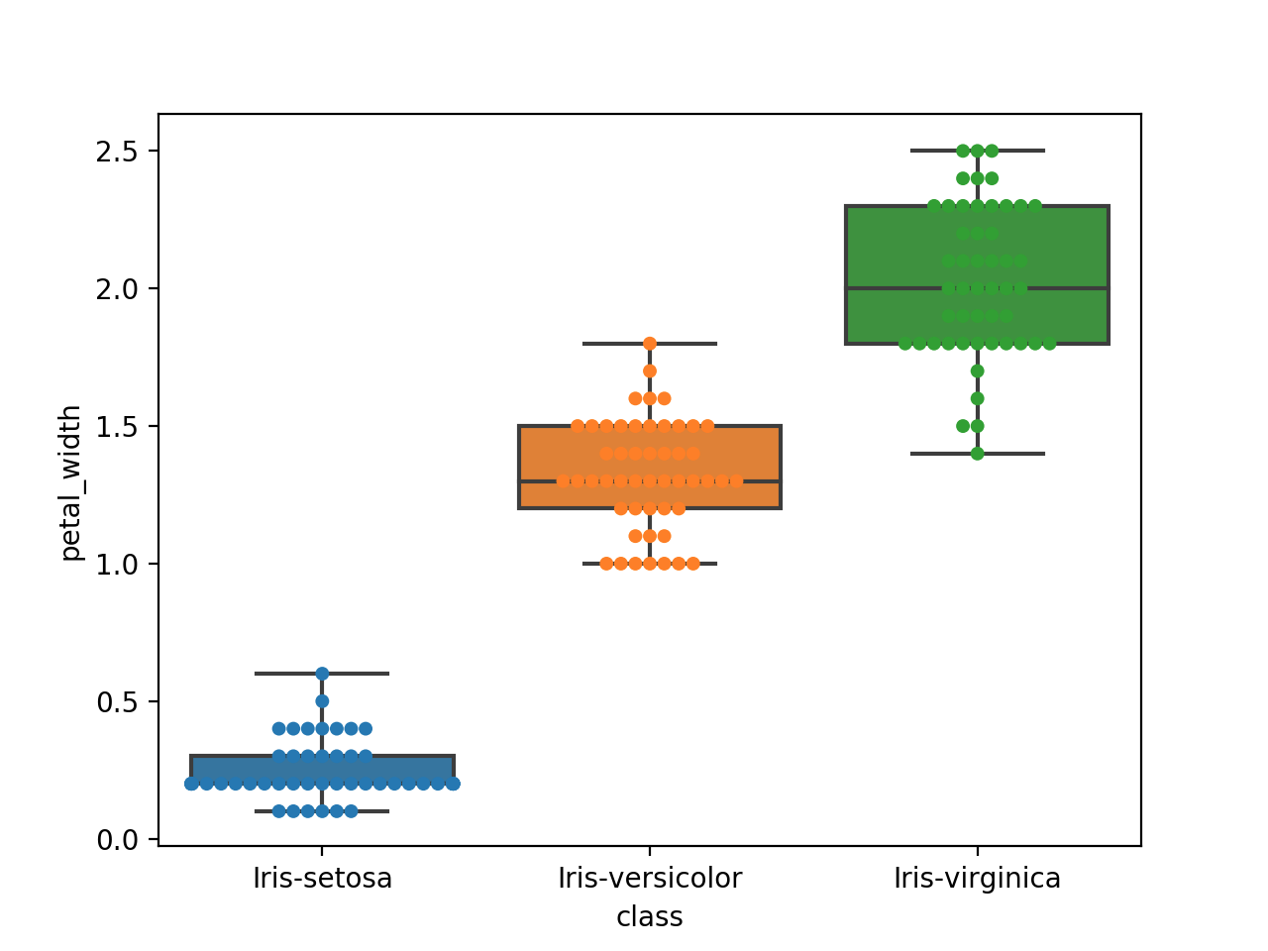
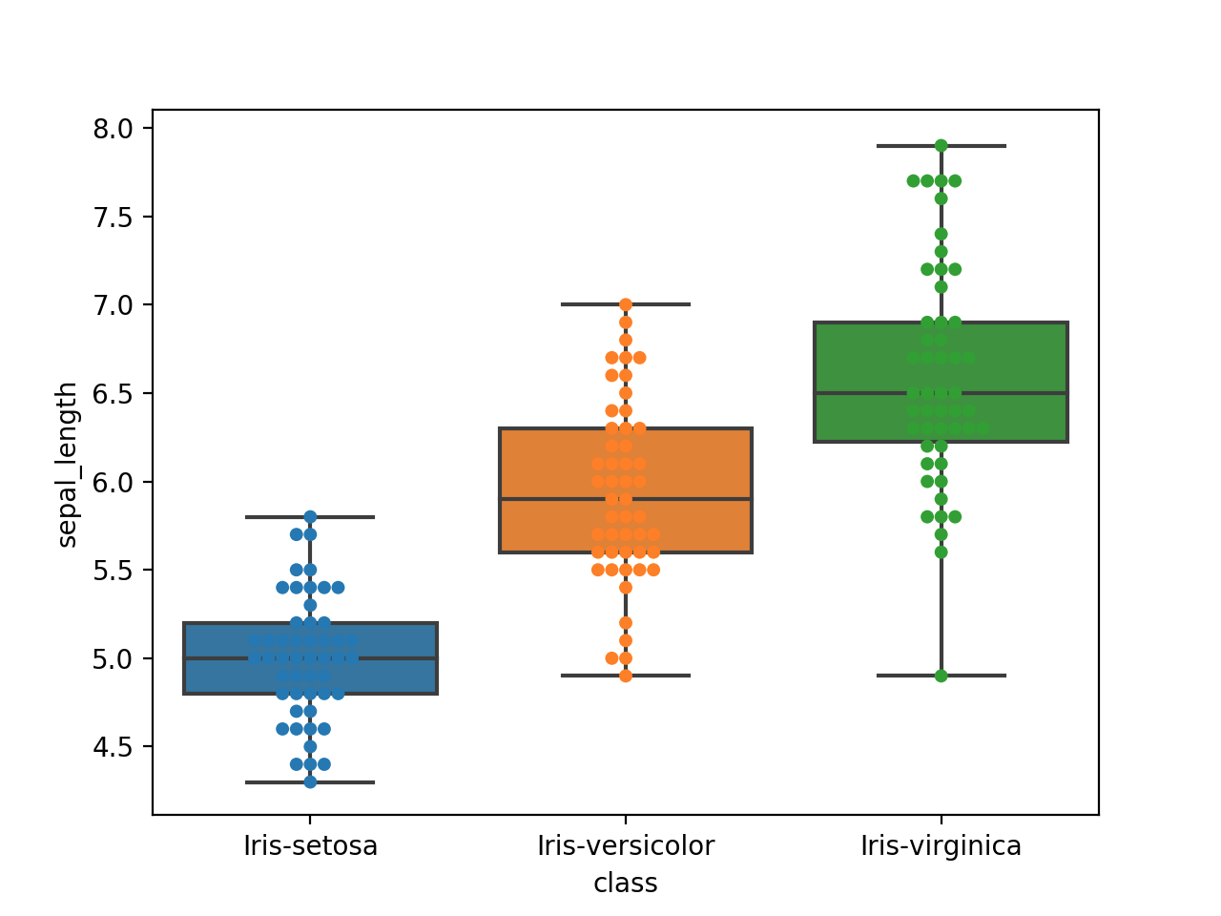
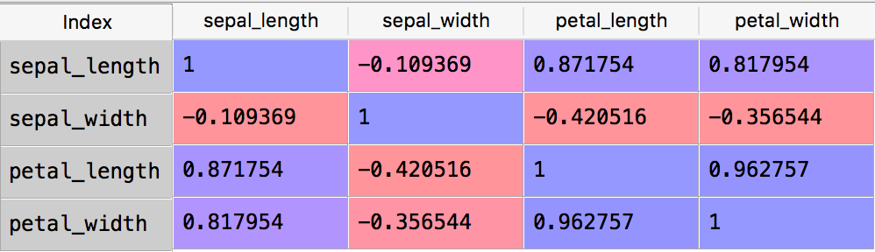
Data description
Iris-setosa species linearly distinguishable in terms of its petal length and width.
Other species appear to be more difficult to visually distinguish based on these features.
Hypothesis: Given the nonlinear nature of the support vector machine it was hypothesised that this algorithm would obtain higher accuracy in comparison to the other two techniques examined.
Correlation Matrix: High Multicollinearity

Slide 4

Methods
Preprocessing: Data scaled to zero mean and unit variance.
Analysis:
Data split into random train and test datasets based on 70:30 split.
Three models tested:
Support Vector Machine (radial basis kernel)
Naive Bayes (gaussian)
Logistic regression
This analysis process is repeated 100 times to achieve a robust estimate of prediction accuracy.
© 2017 Udacity. All rights reserved.

Slide 5
Results & Conclusion
Results
Algorithm | Prediction Accuracy
Support Vector Machine | 96 ± 2.5 %
Naïve Bayes | 95 ± 2.7 %
Logistic Regression | 90 ± 4.5 %
Prediction Accuracy: Mean ± Standard deviation
Conclusion
Based on this limited data set, the Support vector machine and Naive bayes methods outperformed the Logistic regression.
Due to the presence of multicollinearity, future projects should explore the use of regularisation techniques.

Slide 6
Tools & Libraries used
References
Python 3.6
Data Analysis: pandas, numpy,sklearn
Data Visualization: matplotlib, seaborn
Iris data set; Accessed 07/21/18; http://archive.ics.uci.edu/ml/datasets/Iris
Bruce, P. and Bruce, A.; Practical Statistics for Data Scientists: 50 Essential Concepts. 2017. " O'Reilly Media, Inc."
Udacity, Intro to Machine Learning; Accessed 07/21/18; https://eu.udacity.com/course/intro-to-machine-learning--ud120

